Slide 1

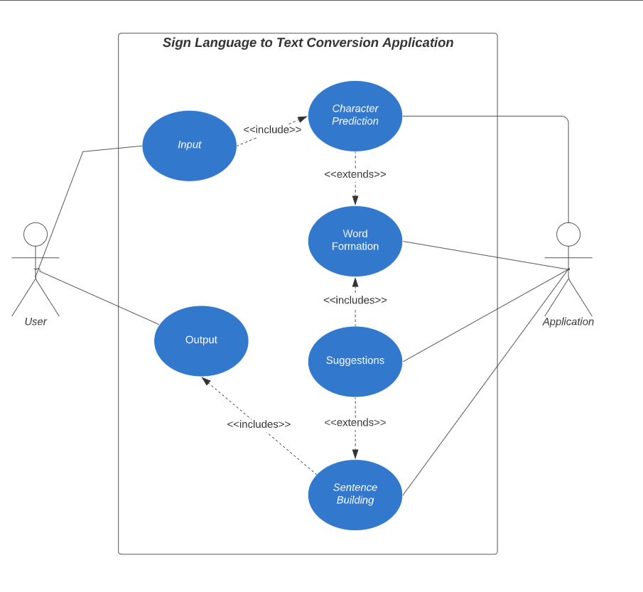
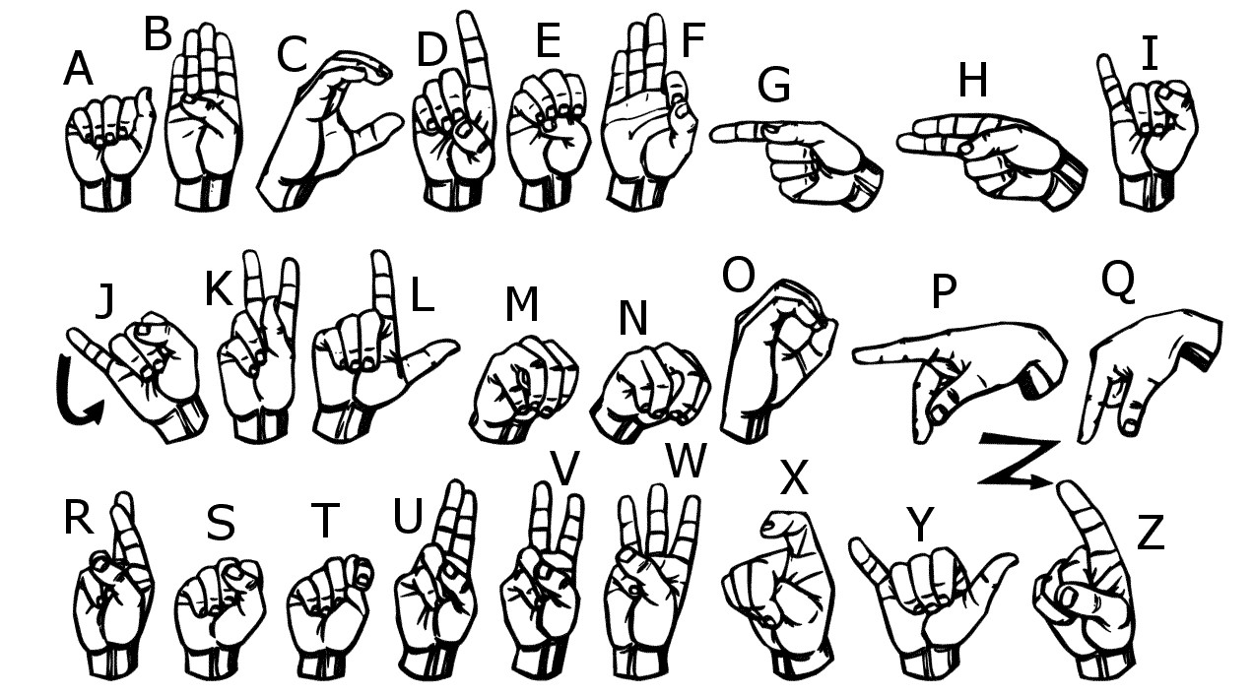
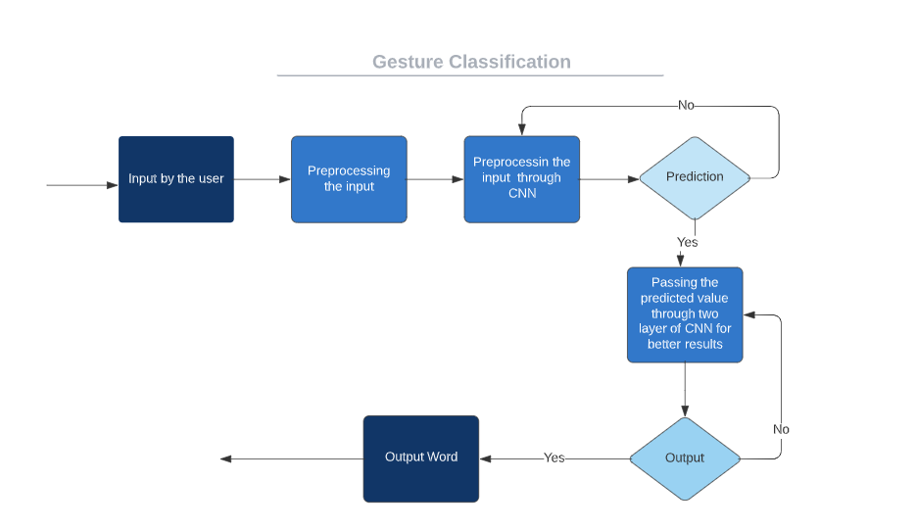

Capstone Project
Sign-Language-to-WordText Converter
by
Team No. 27
Vivekananda Reddy Challa (E23MCAG0138 ), Prashant Yadav (E23MCAG0111), Yashwanth Singh (E23MCAG0139. ),
Lakshaya Tyagi(E23MCAG0142. ) and Tanishq Panwar (E23MCAG0069)
Department of Computer Science Engineering, Bennett University
Abstract
Testing:
Discuss the testing strategies employed to validate the functionality and accuracy of the Sign Language to Word Converter.
Results and Discussion:
Present the results obtained from the system, including performance metrics and any notable observations. Discuss how well the system meets its objectives and potential areas for improvement.
The "Sign Language to Word Converter" project aims to revolutionize communication accessibility by harnessing technology to bridge the gap between sign language and spoken language. Through an innovative and user-friendly interface, this system enables real-time translation of sign language gestures into written or spoken words, facilitating seamless interaction between individuals proficient in sign language and those more comfortable with verbal communication. This transformative tool strives to empower the deaf and hard-of-hearing community, promoting inclusivity and breaking down language barriers in diverse settings such as education, healthcare, and everyday interactions. The project represents a significant step towards creating a more connected and inclusive world by making communication universally accessible..
Introduction
Imagine living in a world where communication is not limited by language barriers. That's the vision behind our Sign Language to Word Converter project. As students passionate about technology and inclusivity, we embarked on this journey to create a tool that bridges the gap between sign language users and those who might not understand sign language.
Turning sign language into words isn't just about making communication easier for individuals; it's about making sure everyone can be a part of society. Research by Huenerfauth shows that this technology can have a big impact on education, jobs, and accessibility. It's a reminder that we need to design these tools with the people who will use them in mind.
Proposed Method
Data Pre-processing:
Detail the steps involved in collecting and pre-processing the sign language data. Discuss any challenges encountered and the methods employed to ensure the quality of the dataset.
Model Evaluation:
Describe the machine learning model used for sign language recognition. Discuss the evaluation metrics and criteria used to assess the model's performance.
Visualization:
Explain how the system's outputs are visualized, aiding in the analysis and interpretation of results.
Design:
Outline the overall design of the Sign Language to Word Converter, including architectural decisions and the integration of machine learning components.
Conclusions
The "Sign Language to Word Converter" project represents a milestone in communication accessibility. Its seamless transition between sign language and spoken words breaks barriers for the deaf and hard-of-hearing community, fostering inclusivity in education, healthcare, and daily interactions. This innovation paves the way for a more universally accessible world, demonstrating the power of technology to connect diverse communities. As a beacon of inclusivity, it signifies progress towards a future where communication transcends limitations, celebrating diversity and understanding among all individuals, irrespective of their preferred mode of communication.
Experimental Results and Discussion
Implementation:
Provide details on the implementation of the system, including programming languages, frameworks, and tools used. Reference code snippets or link to the code repository.
References
National Institute on Deafness and Other Communication Disorders. (2020). "American Sign Language.
Johnson, A. (2021). "The Linguistics of Sign Language." Journal of Communication, Volume(2).
Team No. - 27

